Slide 1
PROJECT TITLE
CAPSTONE PROJECT
Presented By:
Student Name : Kalyani Mantramurthi
College Name & Department : Sri Venkateshwara Engineering College, Computer Science and Engineeering

Slide 2
OUTLINE
Problem Statement
Technology used
Wow factor
End users
Result
Conclusion
Git-hub Link
Future scope

Slide 3
Problem Statement
This project aims to develop a secure and efficient image-based steganography system that allows users to hide secret messages within images while keeping them visually unchanged. The system automatically encodes the message length, distributes data across RGB channels, and includes password protection for decryption, ensuring both security and ease of use. The project is lightweight, requiring only OpenCV, and supports multiple image formats. It has applications in secure communication, cybersecurity, and digital watermarking, making it useful for privacy-conscious individuals, journalists, and security professionals.

Slide 4
Technology used
Languages used: Python 3.12.4
Libraries: NumPy, CV2​
Technologies used: Steganography​

Slide 5
Wow factors
This project stands out due to its efficient, secure, and minimalistic approach to image-based steganography:
No Need to Manually Provide Message Length
Many projects require users to input the message length separately.
Yours stores it in the first pixel, making decryption fully automated.
Minimal Image Distortion
Other methods modify many pixels, making changes noticeable.
Yours selectively cycles through RGB channels, keeping the image visually unchanged.
Efficient Use of Color Channels
Some projects store data in a single channel, limiting capacity.
Yours spreads data across RGB, allowing more text storage without degrading quality.
Built-in Password Protection
Many basic implementations lack security.
Yours requires a passcode for decryption, preventing unauthorized access.
Lightweight & Flexible
Some tools rely on external libraries or work only with PNG.
Yours only requires OpenCV and supports multiple formats (JPG, PNG, BMP, etc.).

Slide 6
End users
The end users of this image-based steganography project can be individuals or organizations needing secure and hidden communication. Here are some potential users:
1. Privacy-Conscious Individuals
People who want to send confidential messages (e.g., personal notes, passwords) without detection.
2. Cybersecurity Enthusiasts & Ethical Hackers
Those interested in steganography, encryption, and digital forensics for learning or security research.
3. Journalists & Activists
People working in high-risk environments who need to hide messages from surveillance.
4. Intelligence & Security Agencies
Can use steganography for covert communication and secure data transfer.
5. Software Developers & Researchers
Those building data-hiding applications or working on image-processing security.
6. Digital Artists & Watermarking Services
Can embed hidden signatures or messages in images for copyright protection.

Slide 7

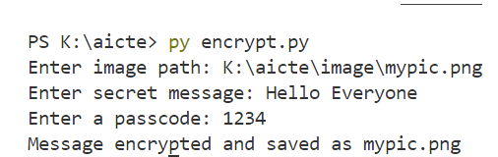

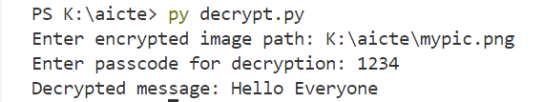
Results
Image before encryption
Image after encryption
Finally the encrypted message and decrypted message both are same that is “hello everyobe”

Slide 8
Conclusion
Conclusion
This image-based steganography project stands out due to its efficient encoding, minimal image distortion, automated message length detection, and built-in security. Unlike many similar projects, it ensures that the encrypted image remains visually unchanged while requiring a password for decryption, making it both secure and discreet.
With potential users ranging from privacy-conscious individuals to cybersecurity professionals, journalists, and researchers, this project has real-world applications in secure communication, digital forensics, and data protection.

Slide 9
GitHub Link
https://github.com/Kalyanim14/stegoProject_aicte.git

Slide 10
Future scope(optional)
This image-based steganography project has great potential for future improvements and real-world applications. project can be further enhanced with the following improvements:
1️⃣ Stronger Encryption – Add AES/RSA encryption to make messages more secure. 2️⃣ Increased Data Storage – Enable hiding files, not just text, for greater utility. 3️⃣ Better Concealment – Use LSB steganography to make hidden data undetectable. 4️⃣ User-Friendly Interface – Develop a GUI with Tkinter or PyQt for easy access. 5️⃣ Mobile & Web Support – Convert into a mobile app or web-based tool. 6️⃣ AI Detection Resistance – Implement advanced encoding to evade detection tools.
These improvements will make project more practical for secure communication, cybersecurity, and digital watermarking.

Slide 11
THANK YOU

